Slide 1

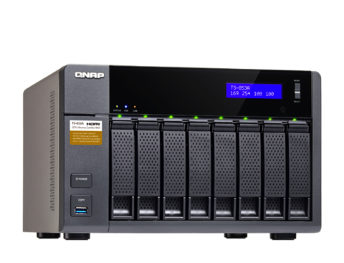
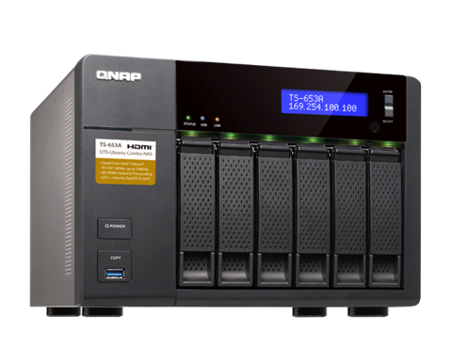

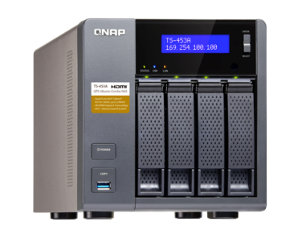

TS-253A / TS-453A / TS-653A / TS-853A
QTS-Linux Combo NAS
Newly Upgraded 14nm Celeron® N3150 Quad-Core Processor
Product Manager Jason Hsu
2015 Dec.

Slide 2
Agenda
Model Introduction
Expansion Unit
Comparison Table
Q&A

Slide 3
TS-x53A Introduction

Slide 4

High-Performance, Low Energy Consumption
Intel
Celeron
N3150
Quad
Core
1.6 ~
2.08GHz
2MB
L2 Cache
6W TDP
Less heat
14nm
64 bit

Slide 5
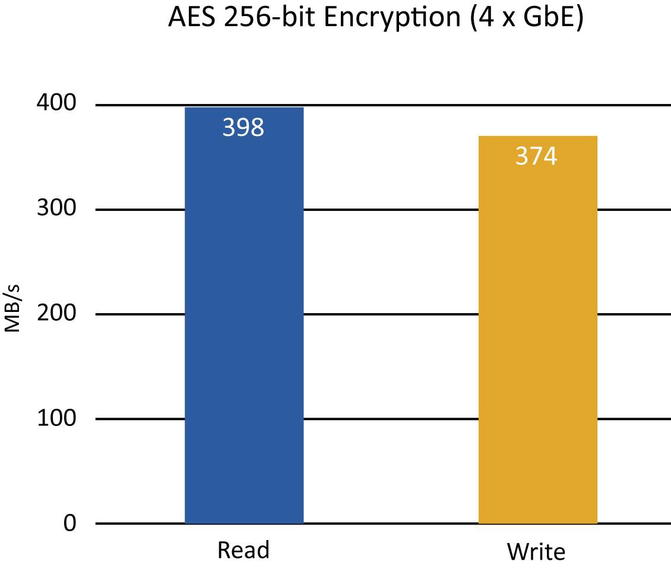
AES-NI Hardware Encryption Acceleration
2X
Performance
Results may vary depending on the environments.
NAS:
QTS 4.2.0
RAID group : RAID 5; 4 x Seagate 1TB ST1000NM0033 HDDs: Direct connections between PCs and the NAS
Client PC:
Intel® CoreTM i7-4770 3.40GHz CPU; DDR3L 1600Hz 16GB; WD 1TB WD10EZEX;
Intel Gigabit CT( MTU 1500 ) ; Windows® 7 Professional 64bit SP1 &
Windows 8.1 Pro 64-bit
IOmeter settings : Multiple PCs attached to a switch and transferred a 32GB file for 3 minutes.
Block size: 64KB, SMB2.0

Slide 6
Max. 8GB Dual Channel Memory Design
4GB / 8GB
Dual-channel
Max 8GB
Expandable
20%
Enhancement
DDR3L-1600
2 x SO-DIMM
x53 Pro x53A
1333 → 1600

Slide 7
Powerful 8th Gen Intel HD Graphics
4K H.264 HQ Video Playback
MKV, AVI, MP4, MOV
multi-format support
30%
Enhancement
640MHz
GPU Max
12EU
Execution Units
x53 Pro x53A
4EU → 12EU

Slide 8

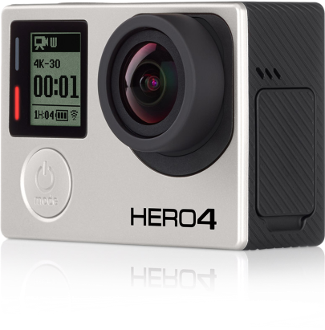

Directing & Recording 4K Movies
Has Never Been Easier
4K
3840x2160
HD
1920x1080
* Source: Apple.com & GoPro.com

Slide 9

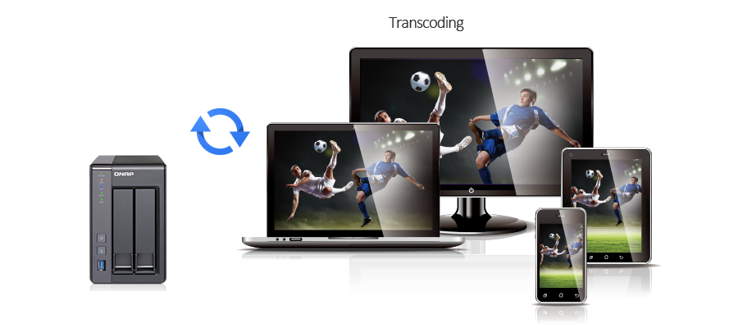
4K H.264 Real-Time & Offline Video Transcoding
Max Concurrent Transcoding
1080p
720p
360p
Source:
4K
2
4
4
Source:1080p
-
8
16
Note: The actual performance may vary based on environments and video quality.
Test environment：
4K video: mpeg4, bitrate: 7.8 Mbps, video codec: h264@high@L5.1, width: 3840, height: 2160, framerate: 30, bit depth: 8, audio codec: AC-3, sample rate: 48000
1080p video: mpeg4, bitrate: 9.7 Mbps, video codec: h264@main@L4.1, width: 1920, height: 1080, framerate: 24, bit depth: 8, audio codec: AAC@LC, sample rate: 48000

Slide 10






Not Just Transcoding; Do More with 4K HDMI
4K
2160p
7.1ch
Digital Audio
Remote
Bundled
1920x1080
Full HD

Slide 11
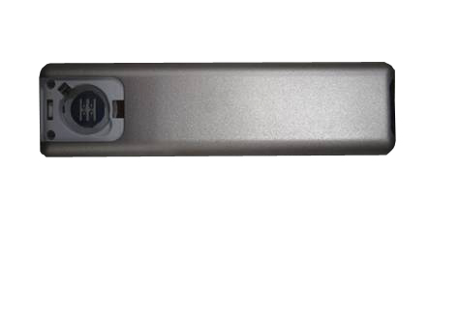
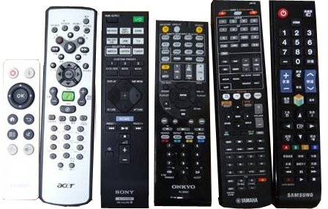

Countless Remotes?
Damaged or Lost?

Slide 12
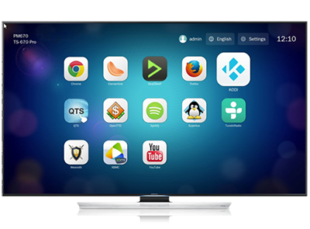
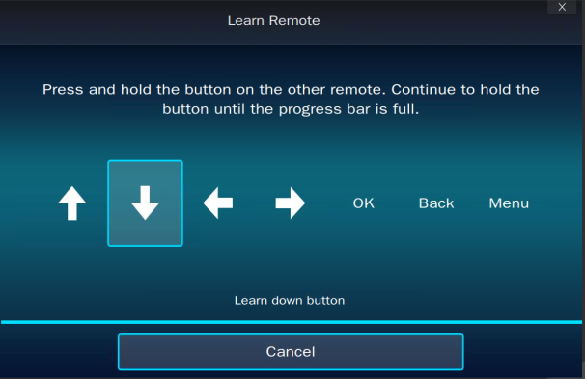
IR Remote Pairing Can Avoid Hassles
Pair your TV or AMP IR remote easily
Navigate, Play, Control
HybridDesk Station
Up to 3 remotes
* Some IR remotes may not be compatible.

Slide 13
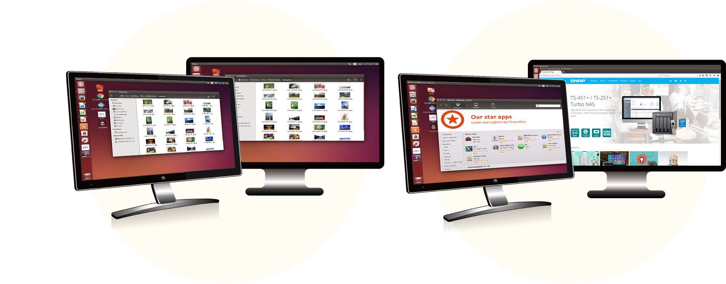
Dual HDMI Output Doubling the Flexibility
Mirroring
Extended Display
Notes:
----- Meeting Notes (12/9/15 13:47) -----
dual VMs

Slide 14
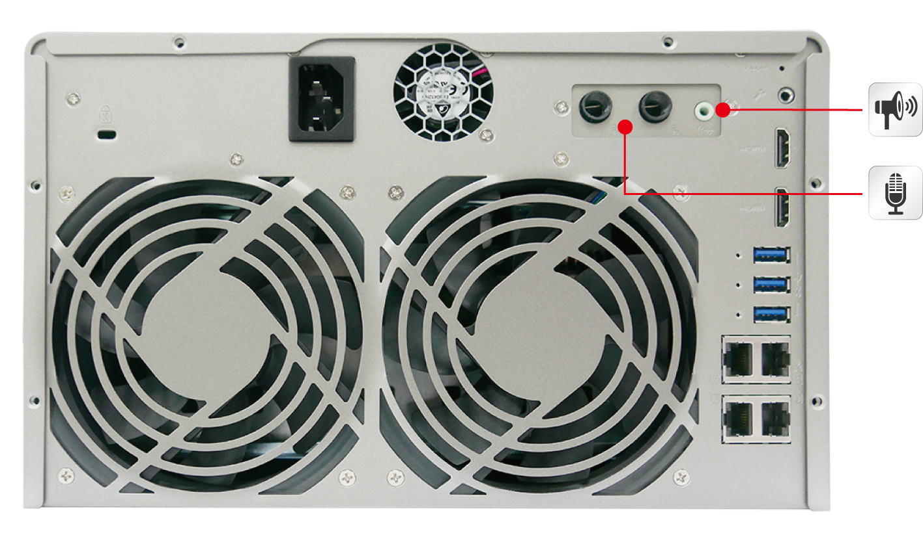
Abundant I / O for Creative App Dev & Use
3.5mm Line-Out
24-bit Digital-Analog Converter
Dual 6.3mm Microphone- In
20-bit Analog-Digital Converter
Front: 1 x USB 3.0
Rear: 3 x USB 3.0
TS-253A: 2 x GbE LAN
TS-453A: 4 x GbE LAN
TS-653A: 4 x GbE LAN
TS-853A: 4 x GbE LAN

Slide 15
Power Supply
TS-253A: 65W AC adapter, 100-240V
TS-453A: 96W AC adapter, 100-240V
TS-653A: 240W internal power supply unit, 100-240V
TS-853A: 240W internal power supply unit, 100-240V

Slide 16
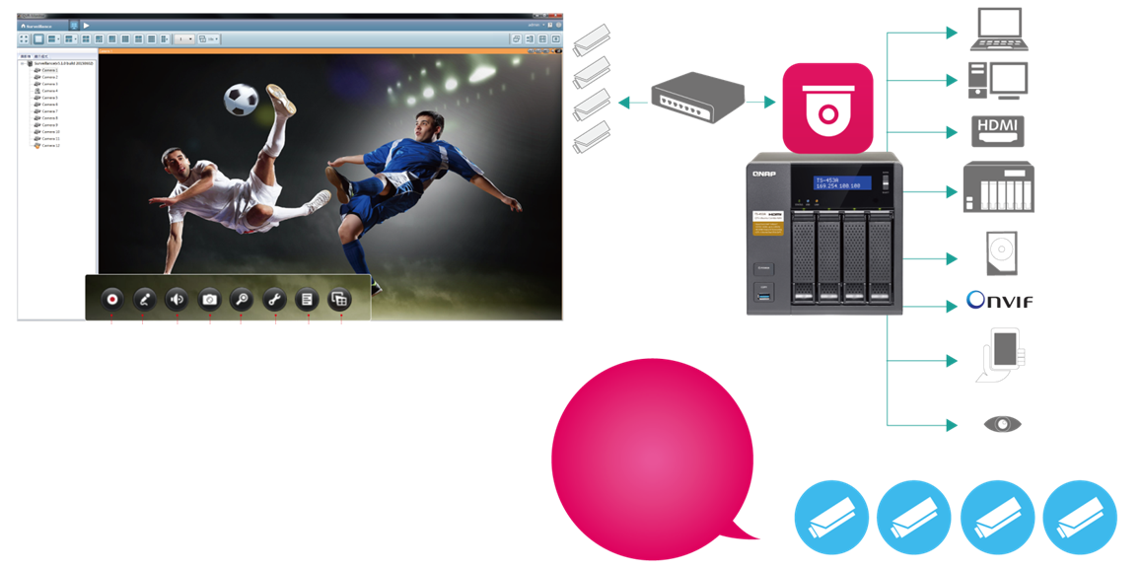
24 x 7 Cloud-Based Surveillance Station
Monitoring
Playback
HDMI Display
Remote Backup
Expansion Unit
RAID Protection
ONVIF
Recording Mic
Speaker
Camera Settings
Point of Interest
Vmobile
Vcam
Zoom in/out
Camera Info
TS-x53Ａ
Free: 4
Max: 40
Licenses
Qdewarp
Fisheye cameras
TS-x53 Pro
2 Free
Camera Licenses
2 More Free

Slide 17
Expansion Unit Support

Slide 18
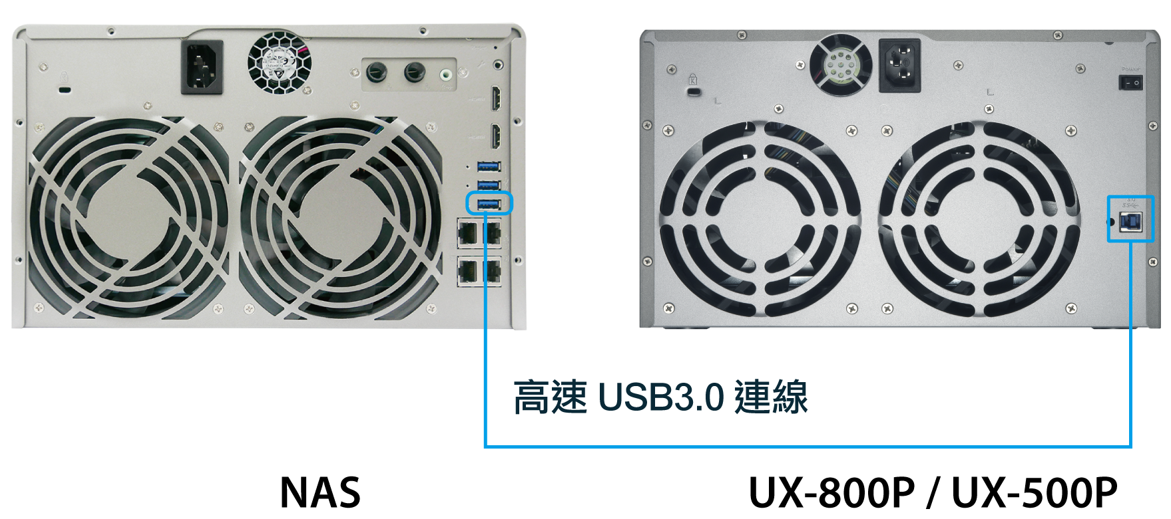
Add Additional 5 or 8 Drives on-demand
Max 1 expansion unit
High-speed USB 3.0

Slide 19
Let’s Compare

Slide 20
 | TS-453A-4G | TS-453 Pro-2G
CPU | 14nm Intel Celeron N3150 Quad-core 1.6GHz, max 2.08GHz | 22nm Intel Celeron J1900 quad-core 2.0GHz, max 2.42GHz
AES-NI HW Encryption | ✔ (Read: 412MB/s, Write: 382MB/s) | ✗ (Read: 208.9MB/s, Write: 165.1MB/s)
GPU | 8th gen Intel HD Graphics, 12EU | 7th gen Intel HD Graphics, 4EU
Memory | 4GB DDR3L-1600, dual channel (2 x 2GB) Expandable to 8GB | 2GB DDR3L-1333, dual channel Expandable to 8GB
USB 3.0 | 4 | 3
Audio In & Out | 2 x 6.3mm Mic. In & 3.5mm Line Out jacks | ✗
HDMI Out | 2 x HDMI, up to 4K 2160p Ultra HD resolution | HDMI 1080P Full HD resolution
IR Receiver | ✔ universal remote learning (free remote control) | ✔ (remote control is optional purchase)
4K H.264 Video | HDMI playback, real-time & offline transcoding | Low-bit rate playback via HDMI & offline transcoding
Operating System | QTS 4.2 + Linux dual OS | QTS 4.2 (Linux OS will be released later)
Karaoke App | OceanKTV + tablet app | Requires optional USB audio box (coming soon)
IP Cam Licenses | Free: 4 / Max: 40 | Free: 2 / Max: 40
Max Concurrent Transcoding | 8 (1080P -> 720P) | 5 (1080P -> 720P)
Notes:
----- Meeting Notes (12/9/15 13:57) -----
bluetooth remote control
6 bay & 8 bay better fan (less noise)
TAS remote only 15 degree each side

Slide 21
 | TS-253A-4G | Other 2-Bay NAS
CPU | 14nm Intel Celeron N3150 quad-core 1.6GHz, max 2.08GHz
AES-NI HW Encryption | ✔
Memory | 4GB DDR3L-1600, dual-channel (2 x 2GB), expandable to 8GB | 2GB, single-channel design
USB 3.0 | 4 | 3
Audio In & Out | 2 x 6.3mm Mic-In & 3.5mm Line-Out jacks | ✗
HDMI Out | Dual HDMI, up to 4K 2160p Ultra HD resolution | ✗
IR Receiver | ✔ universal remote learning (free remote control) | ✗
4K H.264 Video | HDMI playback, real-time & offline transcoding | Only transcoding
Operating System | QTS 4.2 + Linux Dual OS | DSM OS
Install & Run Virtual Machines | Virtualization Station: Windows, Linux/Unix, Android virtual machines | ✗
Karaoke App | OceanKTV + tablet app | ✗
IP Cam Licenses | Free: 4 / Max: 40 | Free: 2 / Max: 30

Slide 22





TS-x53A QTS-Linux Combo NAS
14nm Intel Celeron
Quad-Core 1.6~2.08GHz
4GB / 8GB Dual Channel
DDR3L-1600 SODIMM
Dual HDMI v1.4b
Mirroring or Extended
4K 2160p
Ultra HD Resolution
8th Gen Intel HD Graphics
4K H.264 HW Decoding/Transcoding
Available Now
TS-253A
TS-453A
TS-653A
TS-853A

Slide 23
Q & A
TS-253A
TS-453A
TS-653A
TS-853A
Notes:
Download PDF

